Slide 1



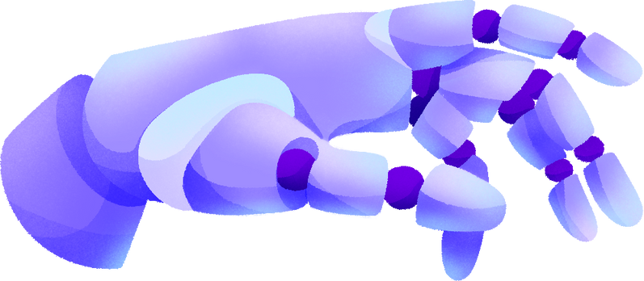



MACHINE LEARNING PROJECT
PREDICTIVE MODELING FOR DISEASE DIAGNOSIS
BY KALPANA S

Slide 2
TABLE OF CONTENTS
Background
Objective
Data Description
Key insights
Technical Architecture
Conclusion

Slide 3

BACKGROUND
Healthcare professionals often rely on various diagnostic tests and biomarkers to assess an individual's
health status and diagnose diseases. In this scenario, we have access to a dataset containing multiple
health-related attributes such as cholesterol levels, blood cell counts, hormone levels, and other
physiological measurements. The dataset also includes information on whether the individual has been
diagnosed with a specific disease or not.

Slide 4

OBJECTIVE
The objective of this project is to develop a predictive model that can accurately classify individuals into diseased or non-diseased categories based on their health attributes. By leveraging machine learning algorithms, we aim to create a reliable tool that healthcare providers can use to assist in disease diagnosis and prognosis.

Slide 5


DATA DESCRIPTION
The dataset consists of the following attributes:
Cholesterol: Level of cholesterol in the blood (mg/dL)
Hemoglobin: Protein in red blood cells carrying oxygen
Platelets: Blood cells aiding in clotting
White Blood Cells (WBC): Immune system cells fighting infections
Red Blood Cells (RBC): Cells carrying oxygen
Hematocrit: Percentage of blood volume occupied by RBC
Mean Corpuscular Volume (MCV): Average volume of RBC
Mean Corpuscular Hemoglobin (MCH): Average amount of hemoglobin in RBC
Mean Corpuscular Hemoglobin Concentration (MCHC): Average concentration of hemoglobin in
RBC
Insulin: Hormone regulating blood sugar levels
BMI (Body Mass Index): Measure of body fat based on height and weight
Systolic Blood Pressure (SBP): Pressure in arteries during heartbeats
Diastolic Blood Pressure (DBP): Pressure in arteries at rest between beats

Slide 6
Triglycerides: Type of fat found in blood (mg/dL)
HbA1c (Glycated Hemoglobin): Measure of average blood sugar levels over past 2-3 months
LDL (Low-Density Lipoprotein) Cholesterol: "Bad" cholesterol
HDL (High-Density Lipoprotein) Cholesterol: "Good" cholesterol
ALT (Alanine Aminotransferase): Liver enzyme
AST (Aspartate Aminotransferase): Enzyme found in liver and heart
Heart Rate: Number of heartbeats per minute (bpm)
Creatinine: Waste product produced by muscles and filtered by kidneys
Troponin: Protein released into bloodstream during heart muscle damage
C-reactive Protein (CRP): Marker of inflammation in the body
Disease: Binary indicator (1: Diseased, 0: Non-diseased)

Slide 7





KEY INSIGHTS
Importing Libraries and Load Datasets
Data Preprocessing
Splitting the data into train and test data
Building a Multiple models
Model Evaluation Metrics
Classification Report

Slide 8
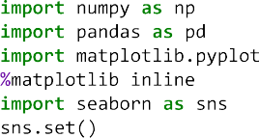
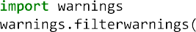
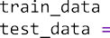
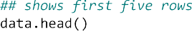
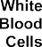
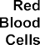
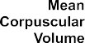
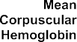
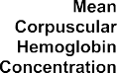
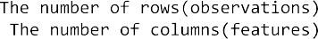

Slide 9
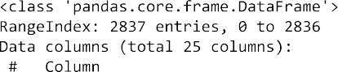
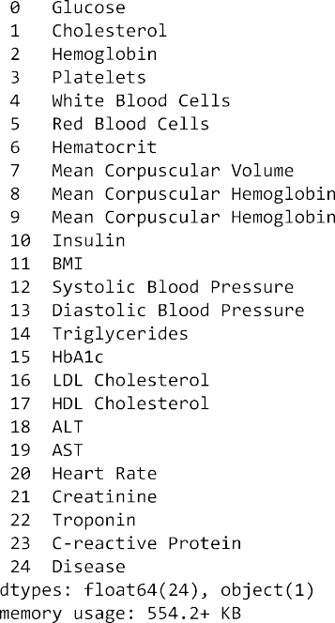
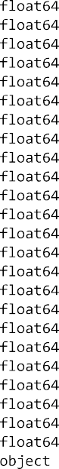
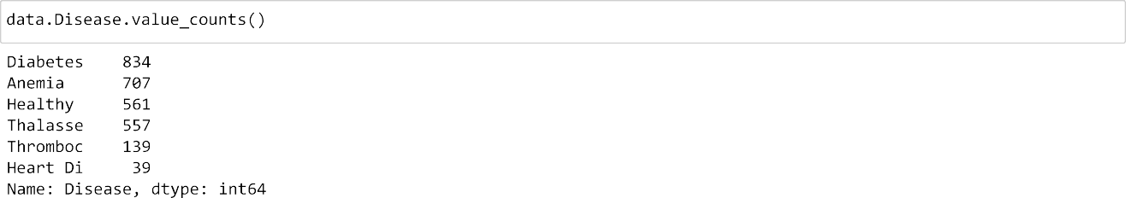
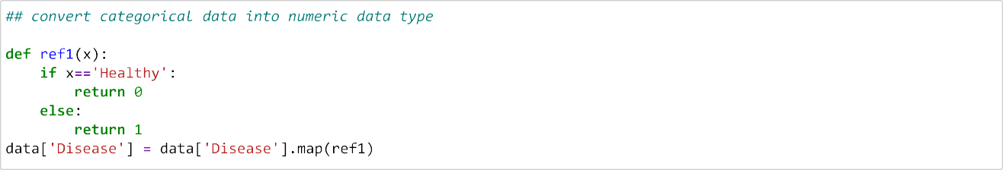
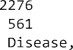

Slide 10
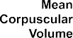

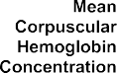
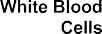
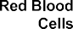
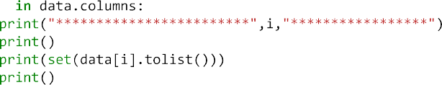
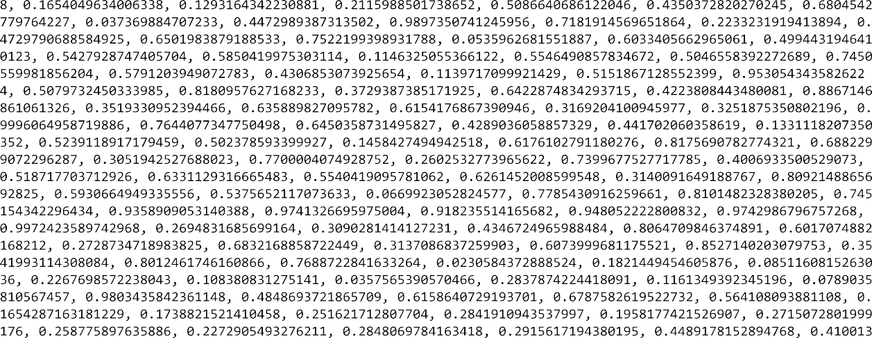

Slide 11
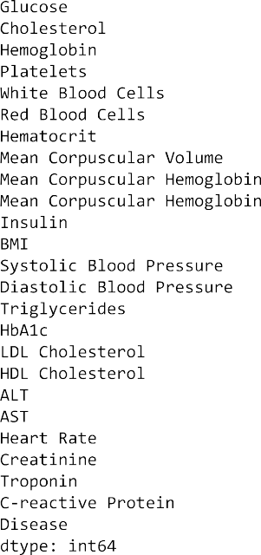

Slide 12
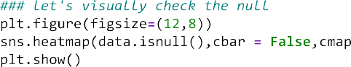
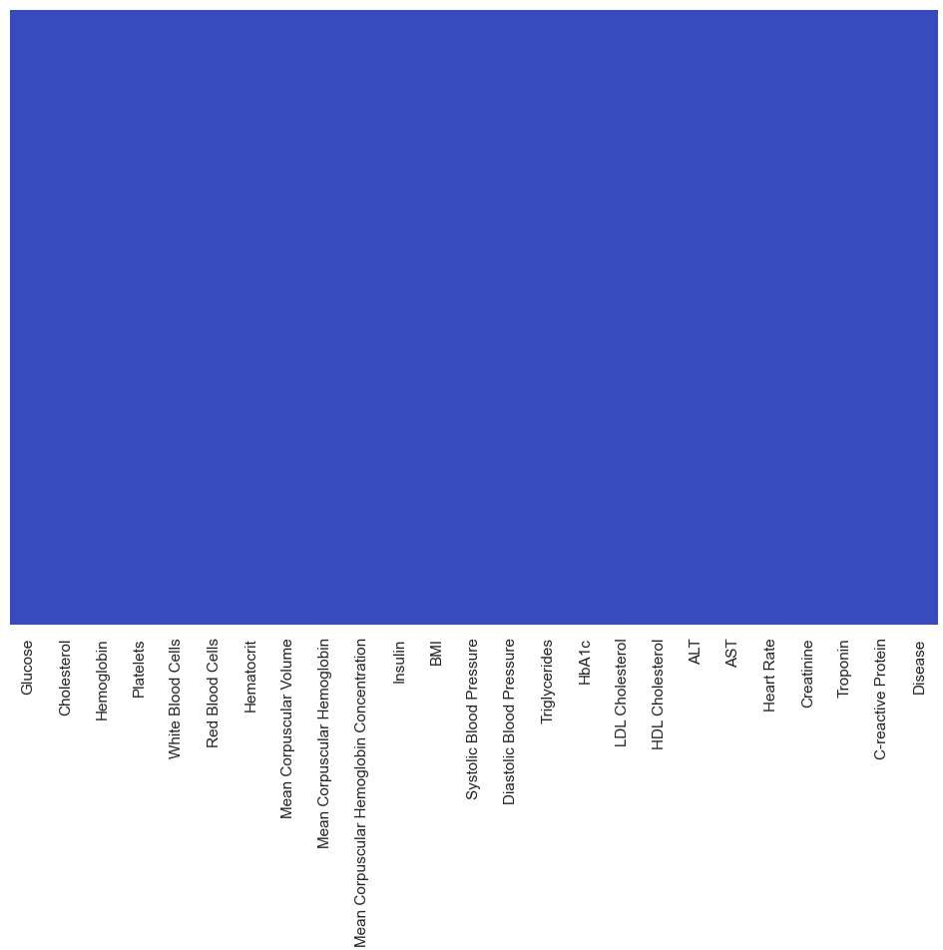
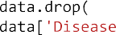

Slide 13
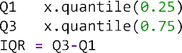
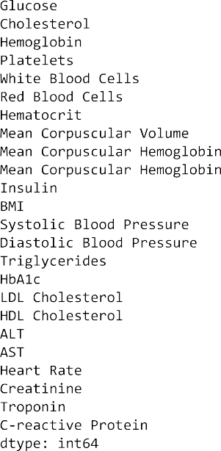
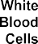
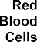
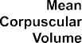

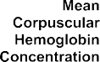

Slide 14
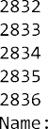
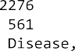
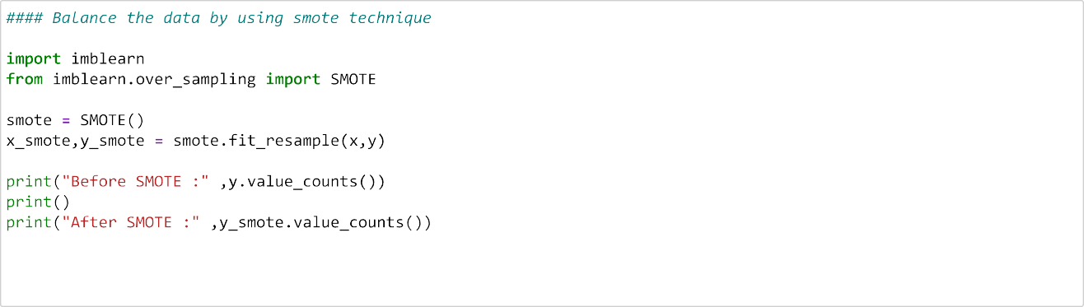
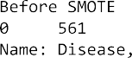
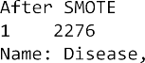
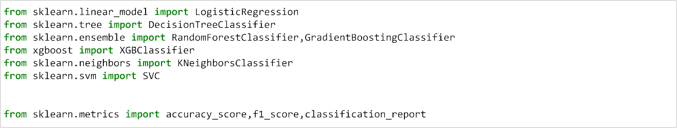
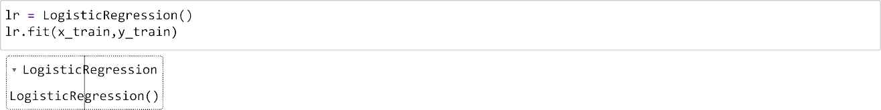

Slide 15
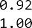
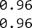
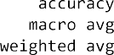
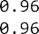
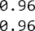
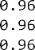

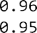

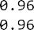
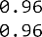
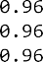




Slide 16








Slide 17










Slide 18




















Slide 19




CONCLUSION
We've employed multiple models in that Random Forest, Decision tree, Support Vector machine achieved an impressive accuracy .

Slide 20

THANK YOU!

